Slide 1
How the environment influences the success of an Airbnb
New York
What makes an Airbnb successful in New York?

Slide 2
Team Members
PAULA CORREA
POLLOB SIKDER

Slide 3
I NY
Airbnb & New York
New York City is one of Airbnb’s largest and most dynamic markets, with thousands of listings spread across diverse neighborhoods. In this presentation, we analyze Airbnb data across NYC districts to understand how room types, pricing, crime levels, reviews, and host behavior influence the market. Our goal is to test several hypotheses and uncover patterns that can help hosts, guests, and policymakers make better decisions.

Slide 4
About Airbnb and NYC Market Context
Brief Background:
New York City has five districts:
Airbnb is a global short-term rental platform.
NYC is one of its busiest urban markets.
Listings vary by:
Room type
Neighborhood
Price
Host type
Manhattan
Brooklyn
Queens
Bronx
Staten Island

Slide 5
Objective of This Analysis
To investigate the following questions:
How are Airbnb room types distributed across districts?
Does crime affect Airbnb prices?
What is the relationship between reviews and price?
Do multiple-listing hosts charge more than single-listing hosts?
Does a higher concentration of subway lines directly translate into increased pricing?

Slide 6
H1
H2
H3
H4
H5
The Airbnb price is fundamentally sensitive to the number of crimes
Subway station density acts as a driver of Airbnb pricing.
Type of Room type shows a correlation with the price
Multiple Listings vs Single Listings Price Comparison
There is a correlation between the price and the airbnb review's number

Slide 7
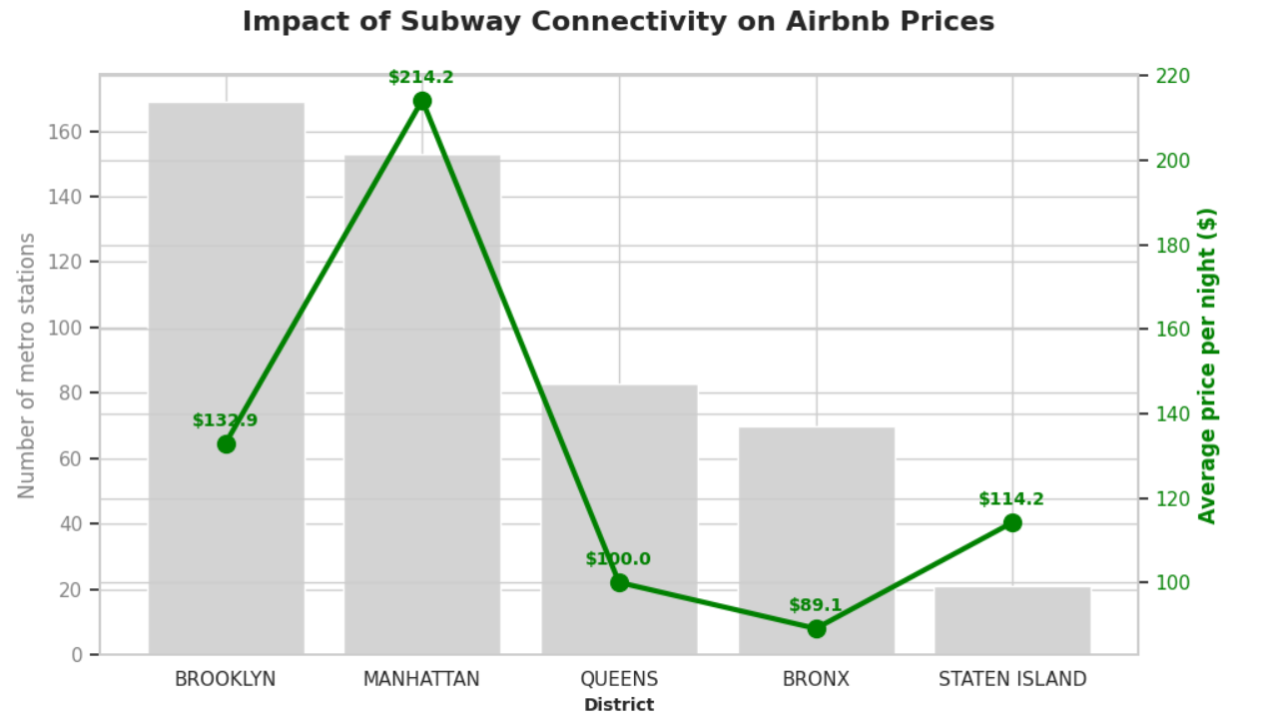
H1: Price / Subway connectivity
Correlation coefficient= 0.63
Infrastructure as a "Price Floor"
Manhattan’s Market Leadership
Brooklyn's Valuation Gap
The Staten Island Exception

Slide 8
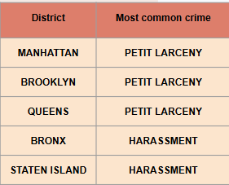
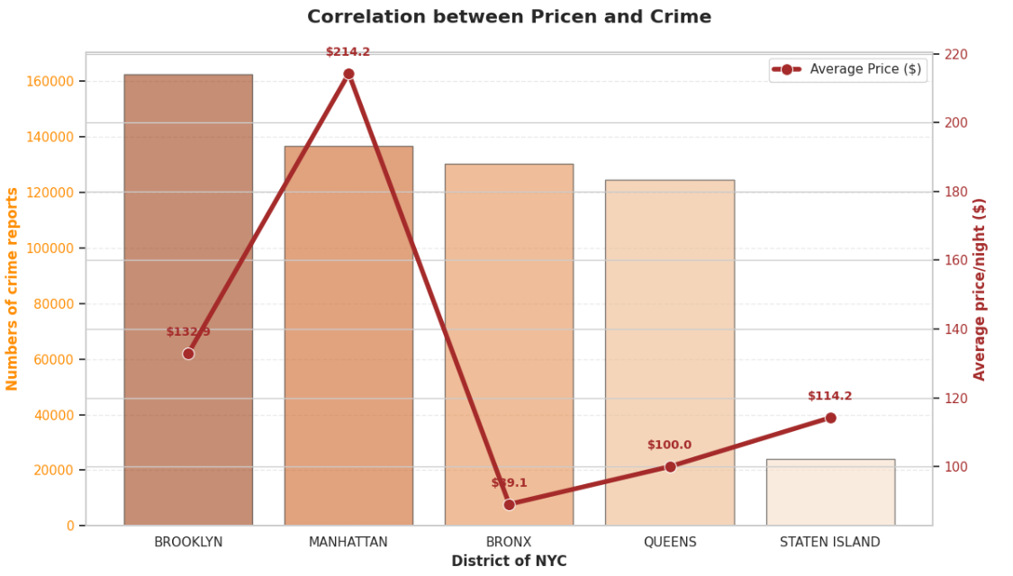
H2: Price / crime
Correlation coefficient= 0.2355
Type of crime is important
Manhattan is the exception
Location is more important than security
Zero impact on the market

Slide 9
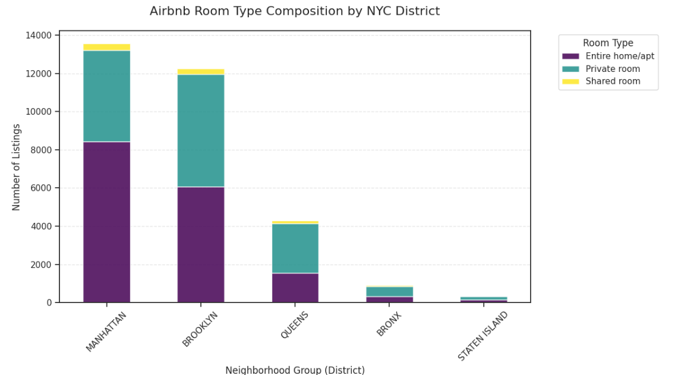
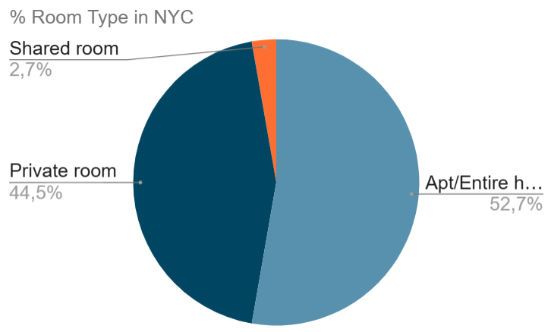
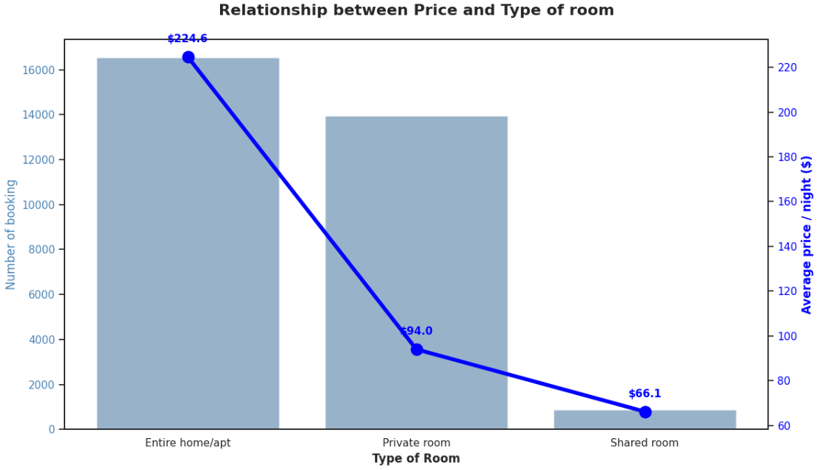
H3: Price / Room Type
Direct correlation
Privacy dominates, few shared options
More privacity, more price
Impact on price
Rally in Manhattan

Slide 10
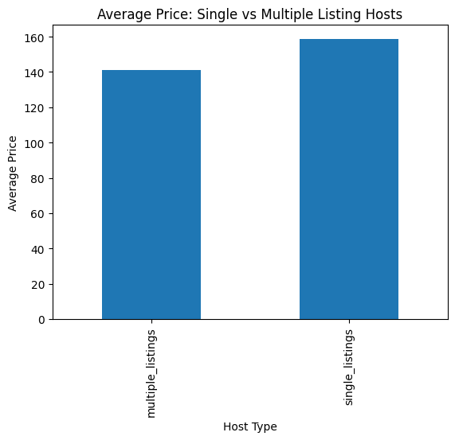
H4: Listing/ price
Hosts with multiple listings have lower average prices than single-listing hosts
Single-listing hosts tend to charge higher prices per property
Multiple-listing hosts may reduce prices to stay competitive in the market
Lower pricing may help professional hosts attract more bookings across many properties

Slide 11
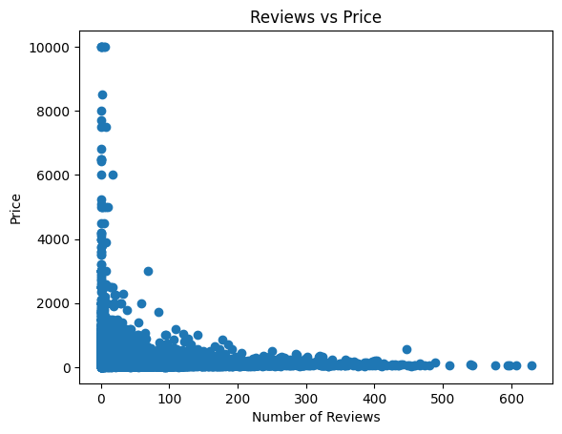
H5: Reviews/ Price
Correlation coefficient = -0.0729
Shows a very weak negative relationship between reviews and price
Listings with more reviews tend to have slightly lower prices
The effect is minimal, so reviews do not strongly influence pricing
Other factors such as location, room type, and neighborhood have greater impact on price

Slide 12
Conclusion
Airbnb pricing in New York City is influenced by multiple factors.
Manhattan has the highest concentration of expensive entire-home listings
Concentration of market (Manhattan and Brooklyn)
Demystifying Crime
The Subway as a magnet for value
Reviews show only a very weak correlation with price, meaning they have limited direct influence on pricing.
Hosts with multiple listings generally charge lower average prices than single-listing hosts due to competitive pricing strategies.

Slide 13
Recommendations
For Hosts:
Use dynamic pricing based on demand, location, and safety trends.
Improve listing quality and encourage reviews to attract more bookings.
For Policymakers:
Monitor multi-listing hosts to maintain fair market competition.
Promote transparent neighborhood safety data for better decision-making.

Slide 14
Struggles in the project
Dataset Definition
KPI & API Alignment
API Integration Challenges
Data Visualization Selection
Code Debugging

Slide 15
THANKS YOU!
Paula Correa
Pollob Sikder
Github_Link: https://github.com/Sikder369/Project_Week_3_Ironhack.git

